Slide 1
Introduction to Programming
Name
@twitterhandle

Slide 2
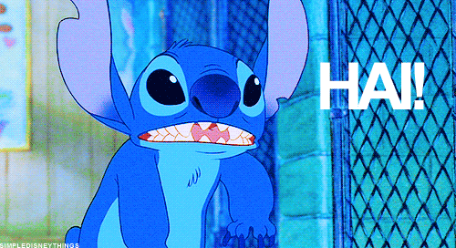
Notes:
Some cute introduction!
(get your own gifs please)

Slide 3
@twitterhandle
Notes:
Hello! I’m XXXX

Slide 4
Programming
Notes:
(This part is because the workshop was given to a female audience, feel free to replace this part with anything very inspirational that calls the attention of your participants)
Before we start on that, I’d like to talk to you a little about the history of programming and the enormous role women have on it.
We often have this idea that programming is a rather masculine profession

Slide 5
is

Slide 6
for

Slide 7
women

Slide 8
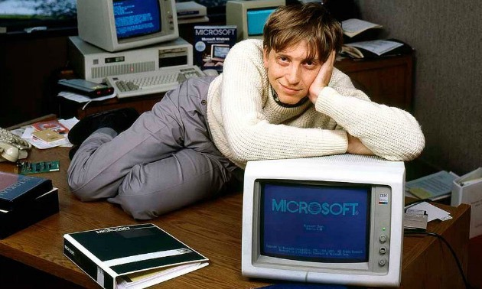
Programming
Notes:
We are bombarded with images like this and sometimes we think it’s been like this since the beginning

Slide 9
Programming
Notes:
But this does not the depict the reality

Slide 10
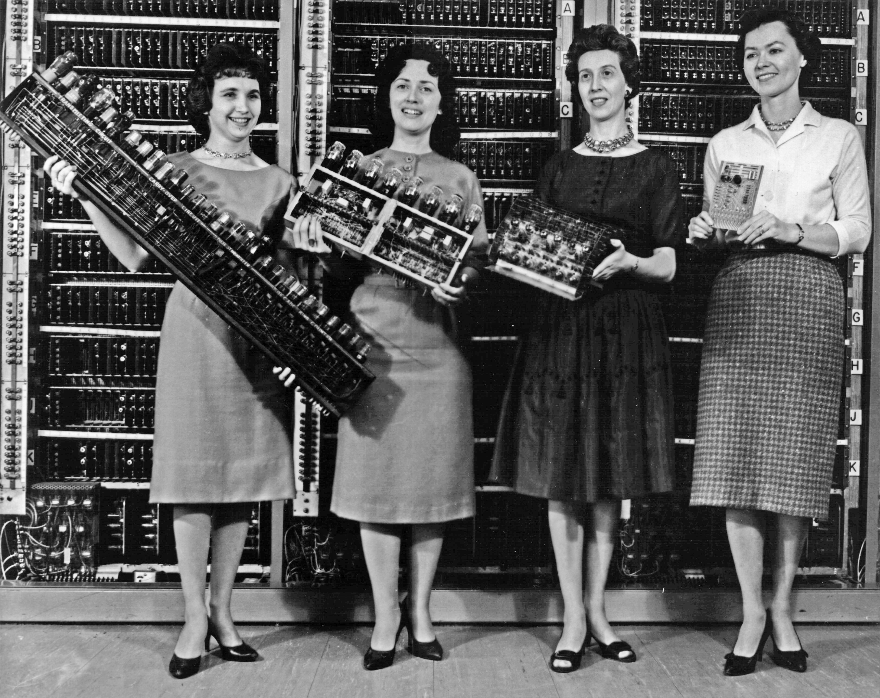
Programming
Notes:
This is the reality! It was once rather feminine and I’ll show you some examples of this

Slide 11
YES!

Slide 12
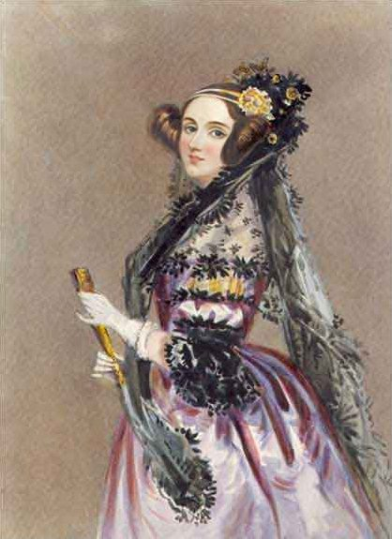
Ada Lovelace
Notes:
Ada Lovelace was a mathematician born in 1815 and was the first person to write an algorithm to be processed by an analytical machine. For that reason, she is considered the first programmer.

Slide 13
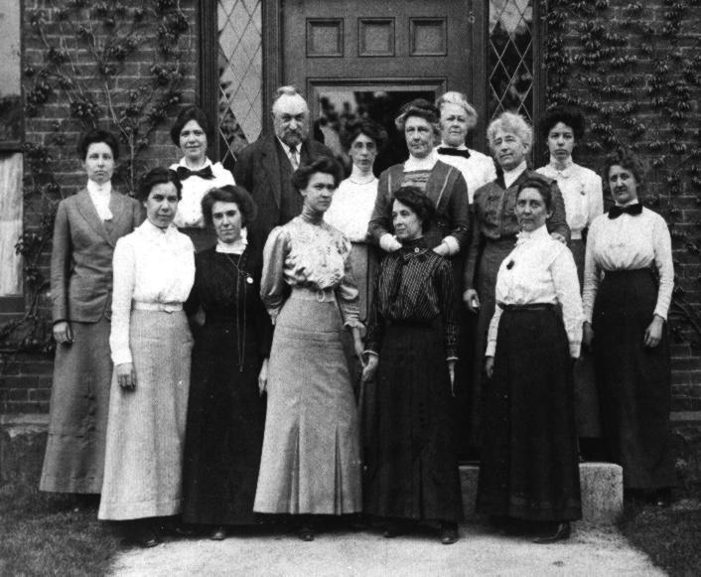
Harvard’s Computers
Notes:
Before the computer was a machine, it was actually a profession. They were people hired to do manual ballistic calculations during WWII. And when they were people, as you can see for this photo, they were also women.

Slide 14
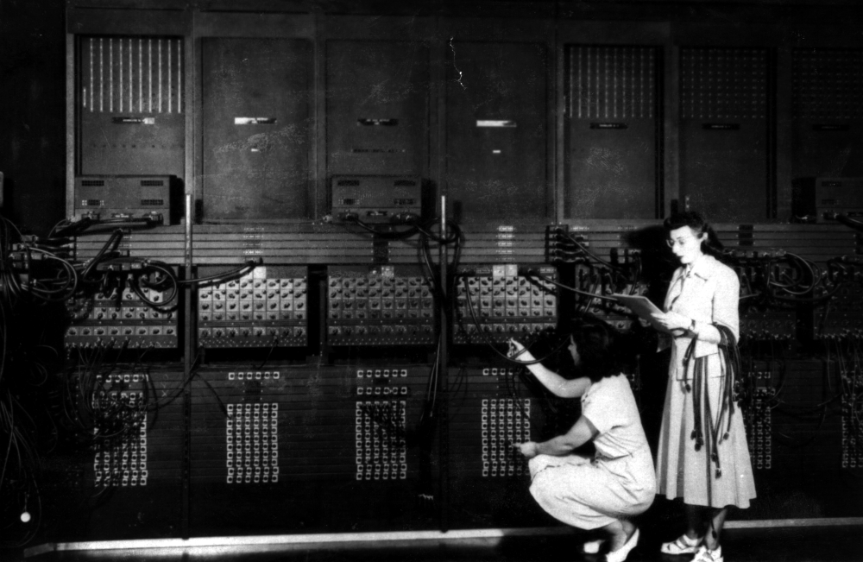
Marlyn Wescoff
Ruth Lichterman
Kay McNulty
Betty Jennings
Betty Snyder
Fran Bilas
Notes:
Out of that team of computers, 6 of them were selected to operate the first electronic general-purpose computer.

Slide 15
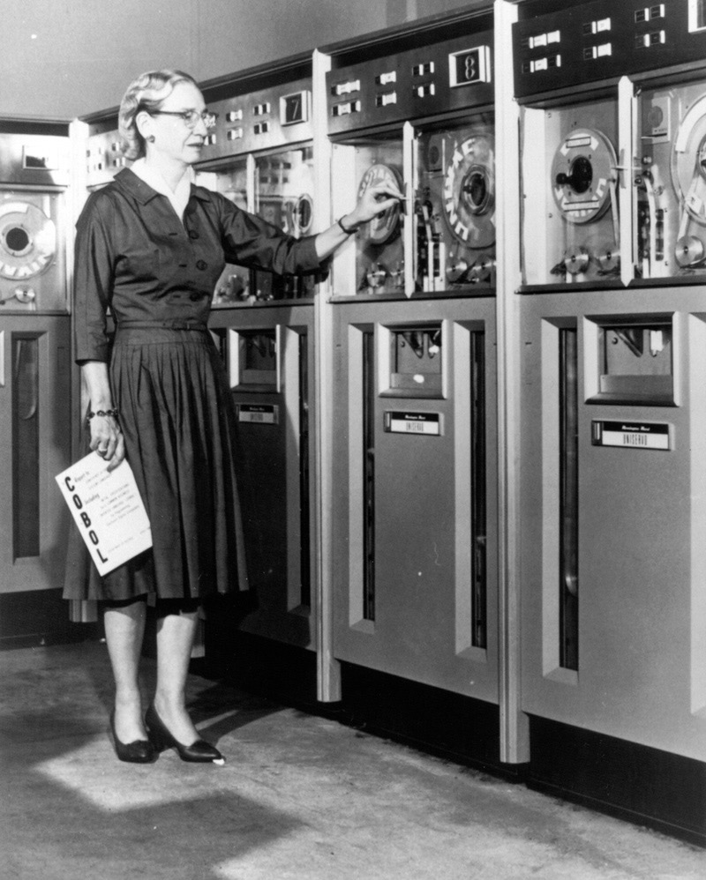
Grace Hopper
Notes:
Grace Hopper was a systems analyst for the united states marine. She invented Flow matic, the first English-like data processing language that later originated COBOL, a programming language used until today. She also wrote the first compiler, for COBOL.

Slide 16
Programming
Notes:
I hope these great women have inspired you to do some programming today! We will not be able to tackle all aspects of web development on this workshop today so we will focus on programming on javascript

Slide 17
Write programs that run on a web browser
Notes:
So my goal is that you leave this workshop able to write as many programs that run on a web browser as you want

Slide 18
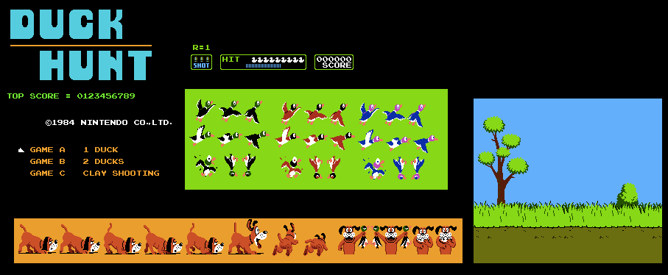
AWESOME GAME
Notes:
To teach you that, we will remake this awesome game and run it on a browser. This is a classical from my childhood, I absolutely adore this game. I hope you like it too

Slide 19
Tools
Notes:
To do this task we will need some tools!

Slide 20
JavaScript
Notes:
The first one is the programming language. To write our programs, we will be using Javascript, that is able to control objects on our pages.

Slide 21
A browser
Notes:
It is embedded on our browsers, so all of us already have what’s necessary to run it. For my examples, the browser I’ll be using is google chrome, but you can try it on any browser (not Internet Exploder). Everything should work fine, but in case you run into something weird I’ll check it with you. :)

Slide 22
Questions?
Notes:
Any questions before we begin? Please feel free to interrupt me and make questions at any moment from now on. Please don’t get shy if you don’t understand one thing. I recognise it might be too much information at once sometimes, so please, if I go too fast or if it seems that I’m speaking alien language, please give me a shout!

Slide 23
http://bit.ly/wil_duck
Notes:
So, to start, please go to bit.ly/wil_duck. You should be redirected to the mozilla thimble page that contains the skeleton of our project code. Mozilla Thimble is an online tool that will make our development and test easier!

Slide 24
Tags!
<canvas> </canvas>
<script>
</script>
Notes:
We will not use a lot of tags on our game, but they basically command some text formatting and create elements on our page that we will later control with javascript. We can write some text and put them inside particular tags to make it bold, for example. One of these tags is the canvas tag that will be essential for what we’re doing today. This is where we will draw our game elements. Another important tag is the tag script. Inside those tags we can write our javascript code.

Slide 25
Comments
//This is not processed
Notes:
Not everything that goes inside the script tag will be processed though. We can write comments that describe what we coded, this is really helpful if somebody else needs to understand your program. In javascript we can comment one line by putting 2 slashes before it and then it wont be processed. Let’s take a look at our code. You can see I’ve put some comments there

Slide 26
Variables
var my_number = 3;
var potato = my_number +3; —> 8
Notes:
Variables are a storage in memory referenced by a symbolic name. This allows us to access the value we stored later, by using the variable name. In javascript we declare a new variable using the keyword var, but to access them we just need their name

Slide 27
Scale
Notes:
See how the size of all our images in our game are multiplied by this var? Let’s increase it and see what happen

Slide 28
Arrays
var duck_1 = { … };
var duck_2 = { … };
var duck_3 = { … }; var ducks = [ {…}, {…}, {…} ]; Ducks[0];
Ducks[1]; etc.
Notes:
There are many types of data we can store in a variable. One of them is an array. An array is basically a way to store multiple values in a single variable. So instead of declaring each duck in our game individually we have a list of ducks.

Slide 29
ducks.push();
ducks.splice();
Notes:
For the moment we have an empty array of ducks. Let’s put our first duck inside it!
We can also remove ducks from our array, but we will take a look at this part later!

Slide 30
Functions
function x (param){
//code
}
var x = function (param){
//code
}
Notes:
Another type of variable is a function. Functions are a block of code that do a particular task. We declare them and them we run them later. Inside the parenthesis are parameters, values that the function might receive that will be necessary for the code inside it. The advantages is that in this way we can reuse our code. We can invoke the same function passing different values to the parameters, for example.

Slide 31
duck.move();
Notes:
OK! Let’s create a function to move our ducks!

Slide 32
Conditions
if( expression) {
// Run code in here if exp
// is true
}
else {
// Run what’s in here if it’s
// false
}
Notes:
Okay, now that we learned some variables, let’s see what happens to our duck! It goes to infinity! In programming there is something called flux control which means that our code can go through different ways depending on what we write. Like conditions. We might need to run different codes on special occasions. Like when our duck passed the screen limit. Let’s fix that!

Slide 33
Comparison Operators
&& And
|| Or
== Equal
> Greater than
< Smaller than
>= Greater or equal than
<= Smaller or equal than
var x = 5;
if( x > 3 ) {
// The code here will RUN because
// x is indeed greater than 3
}
Notes:
First, how do we process expressions and compare values? <explain operators>

Slide 34
Reset duck position if grater than canvas.width
Notes:
Awesome! Now let’s fix the duck

Slide 35
Loops
var sum = 0;
for (i in Ducks){
// Do something for each duck
sum = sum + Duck[i].x;
}
Notes:
Next lesson! Loops :)
(teaching only “for x in” kind of loop today)

Slide 36
hit();
if( expression ) { } for(i in Array){ Array[i].x } Array.splice(position,amount); alert(“Message”);
SIZE OF THE DUCK: 32 x 32 pixels
&& And
|| Or
== Equal
> Greater than
< Smaller than
>= Greater or equal than
<= Smaller or equal than
Notes:
Okay, now I think we have enough for you to work a little bit on your own. Let’s make the hit function and try to kill our duck!
I’ll leave this slide up, so you can take a look.
Also, if you need debugging to see if a part of the code is running, you can put an alert message in the middle of it, it should make a popup message in your browser

Slide 37
Score!
Notes:
What happens when we kill our duck??? Let’s get points!

Slide 38
Math.random();
Notes:
Awesome! But was that the only duck? How about we add some others?

Slide 39
.html
Notes:
Now that we are done, if you want to keep this game and run in the browser whenever you want, copy the text and save in a .html file

Slide 40
Javascript variables
Arrays
Functions
Conditions
Operators
Loops
Notes:
Let’s sum up what we learned today?

Slide 41
AWESOME GAME
Notes:
And we made an awesome game! I hope you enjoyed this <3

Slide 42
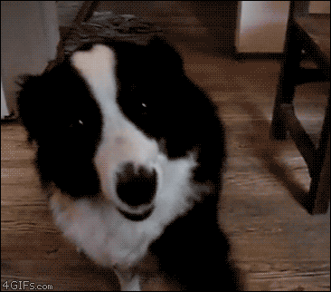
@Etiene_d
Tweet me: @twitter
Notes:
If you have any questions or want to learn further, please don’t hesitate to contact me!
(get your own gifs please)

